Slide 1

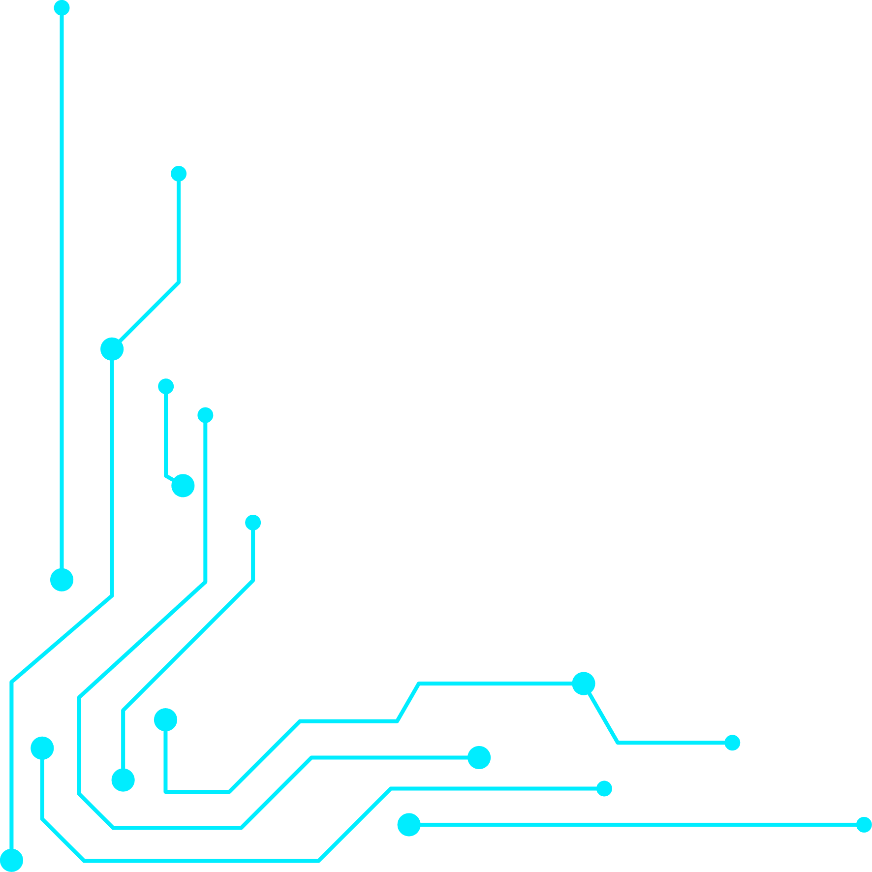




Home
Problem
Solution
TechStack
DataSet
Model
WebApp
Visuals
Future
NARESH D
SSF REVIEW 1
FRAUDSHIELD
SMARTER DETECTION, SAFER TRANSACTIONS
Start Now
https://github.com/nareshdharmaraj/FrausShield
927623BAD067

Slide 2



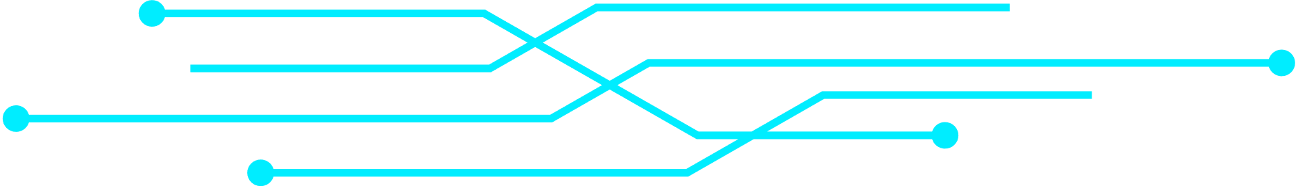

Home
Problem
Solution
TechStack
DataSet
Model
WebApp
Visuals
Future
NARESH D
THE SILENT THREAT: FINANCIAL FRAUD
Issue
Affected
Financial fraud has become more sophisticated with the rise of digital transactions. Traditional rule-based systems are rigid and fail to adapt to new fraud patterns, often resulting in either missed frauds or a flood of false alarms. As transaction volumes grow, these outdated methods struggle with scalability and accuracy.
Banks, financial institutions, and customers are the worst hit. Organizations face financial losses, legal risks, and damaged reputation, while customers suffer from stolen money, breached privacy, and loss of trust in digital payments.

Slide 3





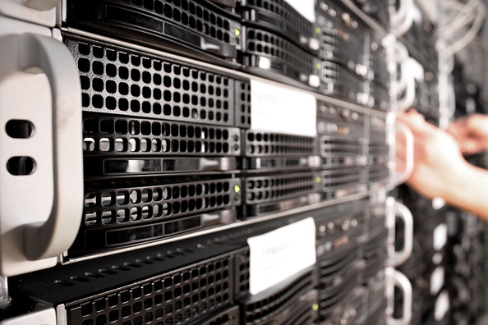
Home
Problem
Solution
TechStack
DataSet
Model
WebApp
Visuals
Future
NARESH D
SMART DETECTION, FASTER ACTION
Proposed Approach
How It Works
We use Machine Learning with Apache Spark to detect fraudulent patterns in financial transactions. Spark ensures speed and scalability, while ML models adapt to evolving fraud tactics.
Users upload or paste transaction data into the system. After preprocessing, ML models like Random Forest and Isolation Forest analyze and flag suspicious transactions.
Impact
The web application displays results in tables and graphs, giving a clear view of fraud patterns. This enables banks and users to act quickly and confidently.

Slide 4
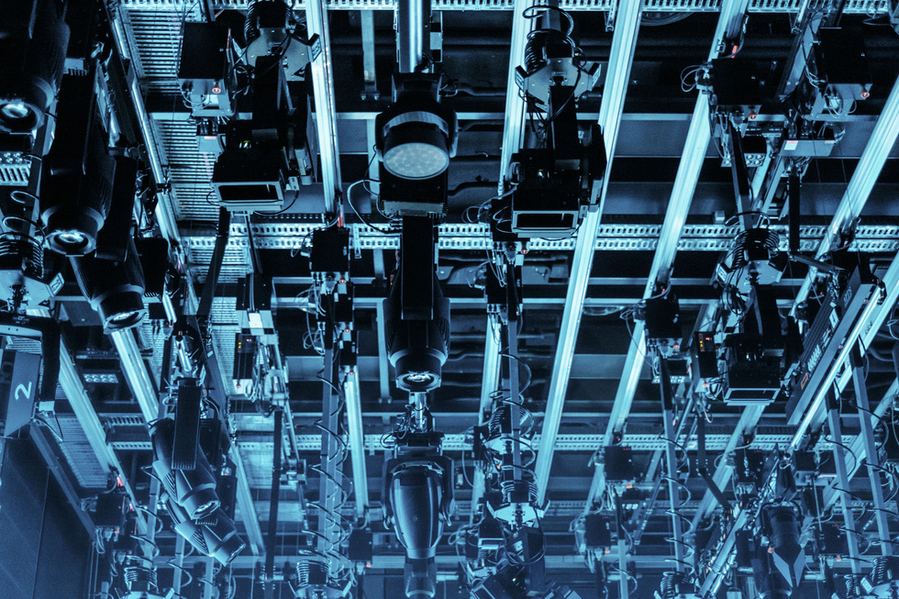
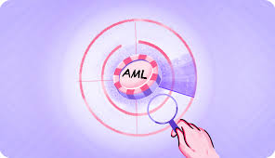


Home
Problem
Solution
TechStack
DataSet
Model
WebApp
Visuals
Future
NARESH D
STACKING UP AGAINST FRAUD
Web & Visualization
Backend: Flask for handling user requests and processing data.
Frontend: HTML, CSS, JS for interactive tables and dynamic visualization.
Visualization Libraries: Matplotlib / Plotly for graphs showing fraud patterns.
Data & Processing
Machine Learning
Apache Spark (PySpark): Handles large-scale transaction data efficiently.
CSV Input : Flexible ingestion from files.
Spark MLlib: Random Forest, Logistic Regression, Isolation Forest for anomaly detection.
Scikit-learn: For additional preprocessing or validation.

Slide 5
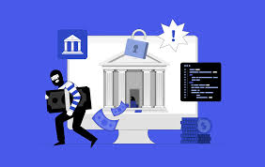

Home
Problem
Solution
TechStack
DataSet
Model
WebApp
Visuals
Future
NARESH D
EVERY TRANSACTION TELLS A STORY
Entities & Attributes
The dataset contains key entities like Transaction, Customer, and Account.
Example attributes: TransactionID, CustomerID, Amount, TransactionType, Location, Time, MerchantID, AccountBalance.
Purpose & Usage
Used to train ML models to distinguish normal vs fraudulent transactions.
Helps analyze patterns like unusual transaction amounts, repeated failed attempts, or atypical locations to flag potential fraud.

Slide 6
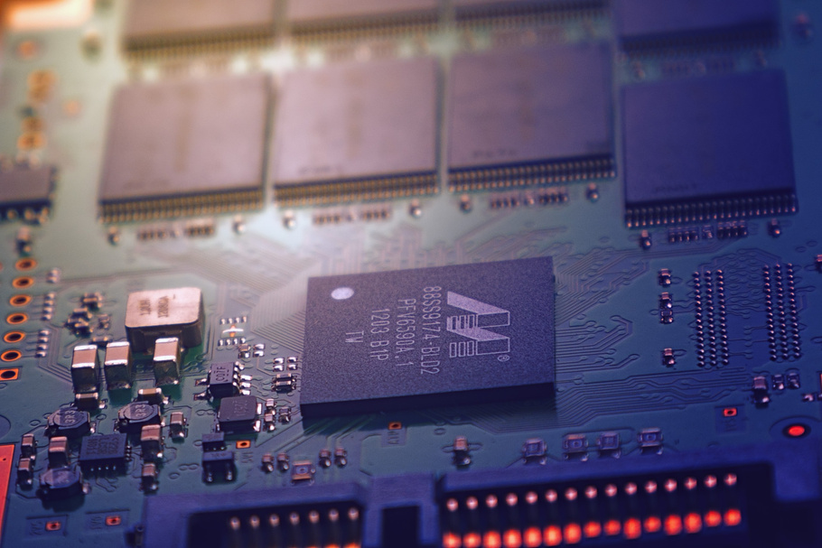
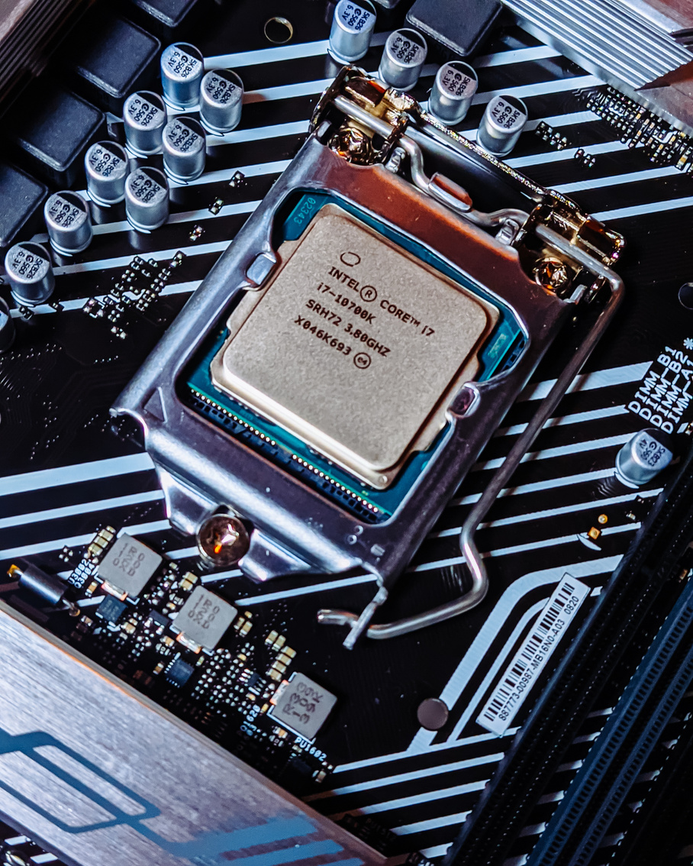
Home
Problem
Solution
TechStack
DataSet
Model
WebApp
Visuals
Future
NARESH D
Smart Algorithms at Work
THE BRAIN THAT SPOTS FRAUD
We use Random Forest, Logistic Regression, and Isolation Forest to detect suspicious transactions.
These models learn patterns from the dataset to separate normal behavior from anomalies, making detection accurate and adaptive.
How They Think
Each transaction is evaluated on features like Amount, Frequency, Location, and Time.
Isolation Forest isolates outliers, while Random Forest and Logistic Regression assign fraud probabilities, giving a precise “fraud score” for each transaction.

Slide 7




Home
Problem
Solution
TechStack
DataSet
Model
WebApp
Visuals
Future
NARESH D
FRAUD DETECTION AT YOUR FINGERTIPS
Interactive Interface
Users can upload a CSV or paste transaction data directly into a table.
The system dynamically recognizes the data and prepares it for analysis.
Dynamic Results
Fraudulent transactions are flagged automatically in the table.
Graphs and charts provide visual insights like fraud distribution, high-risk customers, and transaction trends.
Enables instant feedback for users, making fraud monitoring fast and intuitive.

Slide 8


Home
Problem
Solution
TechStack
DataSet
Model
WebApp
Visuals
Future
NARESH D
SEE FRAUD IN ACTION
Reason
Provides a clear and concise view of fraud patterns.
Helps users quickly identify anomalies and understand trends without analyzing raw data.
Enhances decision-making and makes results user-friendly.
Visuals Used
Bar Charts: Show the number of fraudulent vs normal transactions.
Line Charts: Highlight trends of fraud over time.

Slide 9

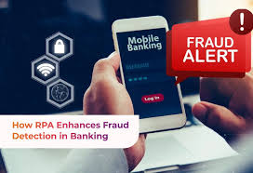
Home
Problem
Solution
TechStack
DataSet
Model
WebApp
Visuals
Future
NARESH D
NEXT FRONTIER IN FRAUD DETECTION
Enhancements
Broader Scope
Integrate real-time streaming data for instant fraud alerts.
Expand ML models with deep learning for more complex anomaly detection.
Extend the web app to support multiple banks and financial institutions.
Add predictive analytics to prevent fraud before it happens.

Slide 10

Home
Problem
Solution
TechStack
DataSet
Model
WebApp
Visuals
Future
NARESH D
THANK YOU
STAY CONNECTED!

